Slide 1
Machine Learning 07- Decision Tree
Dr. Malak Abdullah
Computer Science Department
Jordan University of Science and Technology

Slide 2
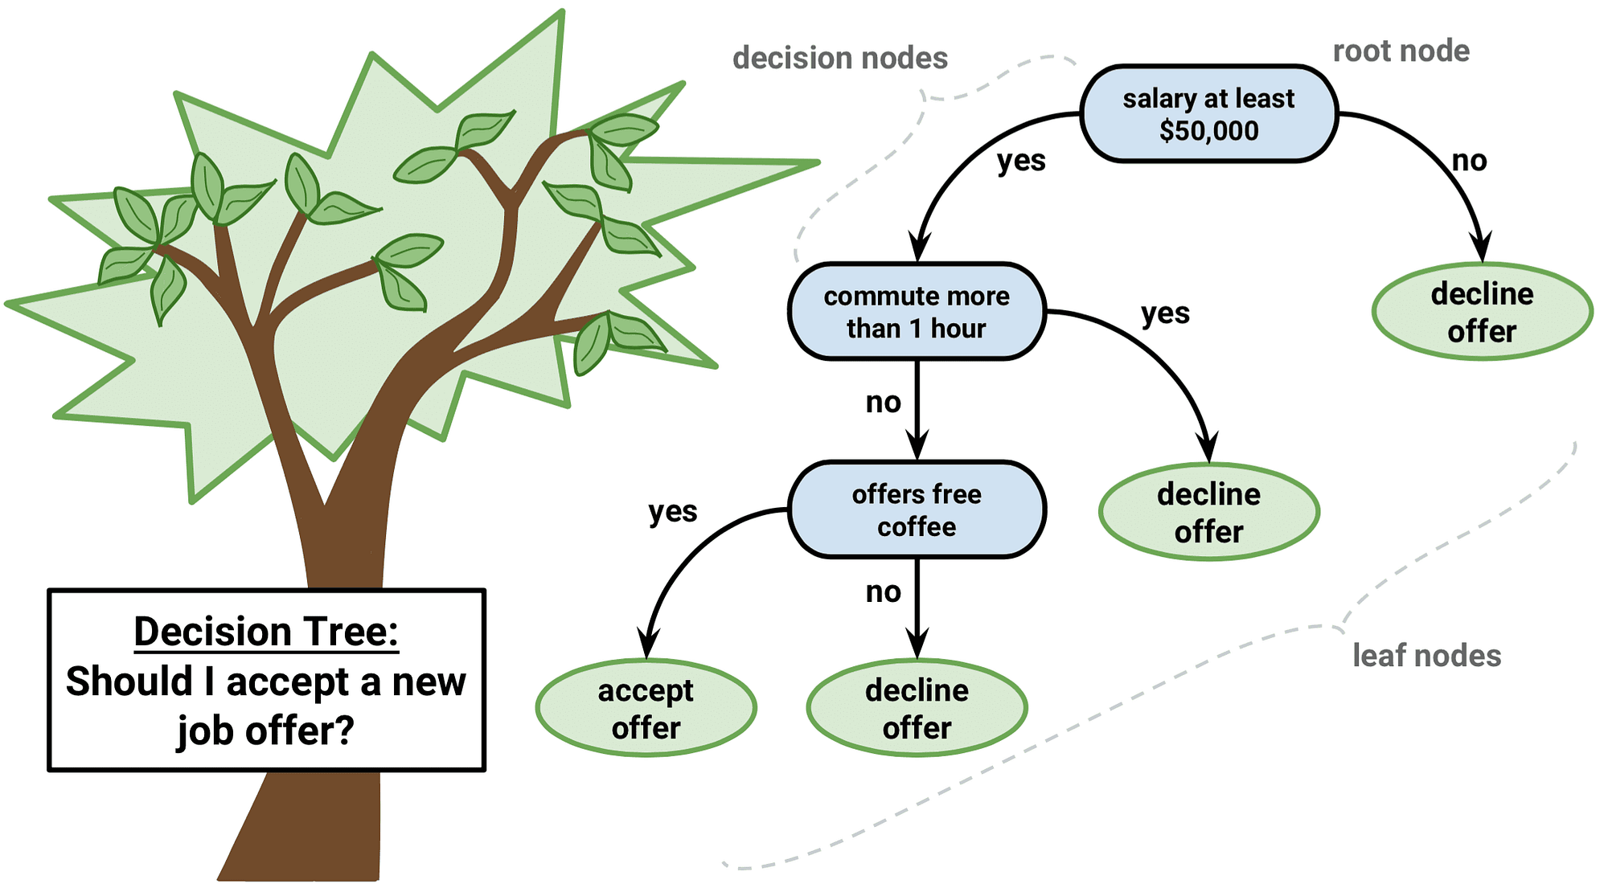
Decision tree
A decision tree is a tree where each node represents a feature (attribute), each link (branch) represents a decision(rule) and each leaf represents an outcome (categorical or continues value).

Slide 3
Decision Tree
Decision Tree : Decision tree is the most popular tool for classification and prediction. A Decision tree is a flowchart-like tree structure where each internal node denotes a test on an attribute, each branch represents an outcome of the test, and each leaf node (terminal node) holds a class label.
Decision tree is a type of supervised learning algorithm (having a pre-defined target variable) that is mostly used in classification problems. It works for both categorical and continuous input and output variables. In this technique, we split the population or sample into two or more homogeneous sets (or sub-populations) based on most significant splitter / differentiator in input variables.
The decision tree algorithm tries to solve the problem by using tree representation. Each internal node of the tree corresponds to an attribute, and each leaf node corresponds to a class label.

Slide 4
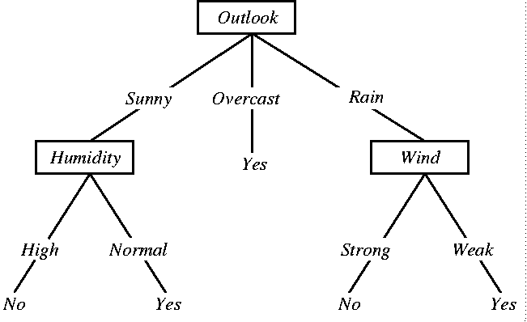
A Simple Decision Tree
The main drawback of Decision Tree is that it generally leads to overfitting of the data

Slide 5
Representation
internal node = attribute test
branch =attribute value
leaf node = classification

Slide 6
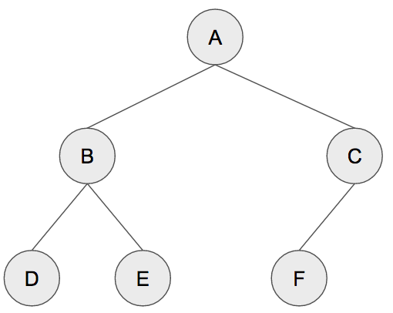
The tree
Terminology
Root = A
Depth =2
Leaf = D E F
a binary tree, each parent node must have at most 2 child nodes

Slide 7
Assumptions while creating Decision Tree
At the beginning, the whole training set is considered as the root.
Feature values are preferred to be categorical. If the values are continuous, then they are discretized prior to building the model.
Records are distributed recursively on the basis of attribute values.
Order to place attributes as root or internal node of the tree is done by using some statistical approach.

Slide 8
Decision Tree
Very simple yet powerful supervised learning methods
Utilizes an if-then rule set
The rules are learned sequentially using the training data one at a time
For each attribute in the dataset, the algorithm forms a node, where the most important attribute is placed at the root node.
Each time a rule is learned, the tuples covered by the rules are removed.
This process is continued on the training set until meeting a termination condition.
A decision tree can be easily over-fitted generating too many branches and may reflect anomalies due to noise or outliers
This can be avoided by pre-pruning which halts tree construction early or post-pruning which removes branches from the fully grown tree

Slide 9
Decision Trees in Machine Learning
We can use the following dataset to build a decision tree that could help us predict the brand of laptop college students prefer.
This model can help us in marketing.
# | Gender | Age | Major | Laptop
1 | M | 22 | IT | HP
2 | F | 21 | IT | HP
3 | M | 35 | ENG | HP
4 | F | 31 | IT | HP
5 | M | 29 | IT | HP
6 | F | 24 | ENG | DELL
7 | M | 34 | ENG | DELL
8 | F | 39 | ENG | DELL
9 | M | 25 | IT | DELL
10 | F | 30 | ENG | DELL

Slide 10
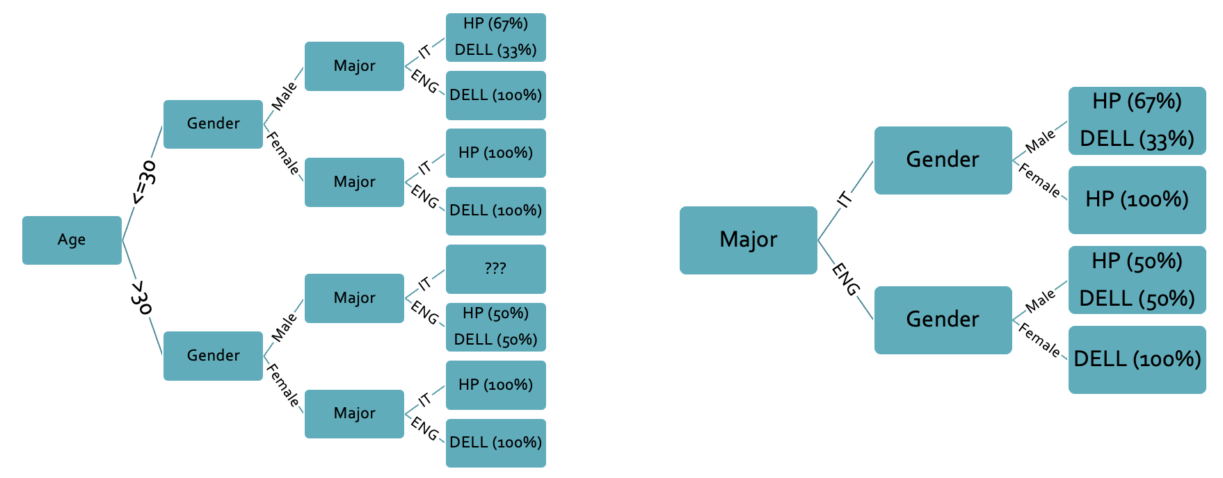
Decision Trees in Machine Learning
# | Gender | Age | Major | Laptop
1 | M | 22 | IT | HP
2 | F | 21 | IT | HP
3 | M | 35 | ENG | HP
4 | F | 31 | IT | HP
5 | M | 29 | IT | HP
6 | F | 24 | ENG | DELL
7 | M | 34 | ENG | DELL
8 | F | 39 | ENG | DELL
9 | M | 25 | IT | DELL
10 | F | 30 | ENG | DELL
Many unique decision trees could be created for the same dataset, especially when the dataset contains numerous continuous variables.
Despite the two decision trees' almost equal effectiveness, the second decision looks simpler, which is better in machine learning.
Simple enough machine learning models are usually more effective and efficient than complex models.

Slide 11
Splitting
Trying to find and return the smallest possible decision tree that accurately classifies the training set is very very hard. In fact, it’s an NP-hard problem.
Instead, we’ll try to approximate the best result instead of getting the best result. We’re going to talk a lot about probability and statistics.
What we want is information that explicitly splits the data into two. We don’t want something that can include both A and B classes, we want purity. One singular class for each split.
The measure of purity is called information. It represents the expected amount of information that would be needed to specify whether a new instance should be classified as the left or right split.
Entropy is a measure of impurity. It’s how uncertain something is.

Slide 12
DT algorithms
Decision trees use multiple algorithms to split a node into two or more sub-nodes. The creation of sub-nodes increases the homogeneity of the resultant sub-nodes. In other words, the purity of the node increases with respect to the target variable. A decision tree splits the nodes on all available variables and then selects the split that results in the most homogeneous sub-nodes.
The algorithm selection is also based on the type of target variables. The four most commonly used algorithms in decision trees are:
Gini Index
Information Gain
Chi-square
Reduction in Variance

Slide 13
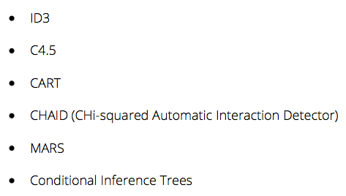
Decision Trees

Slide 14
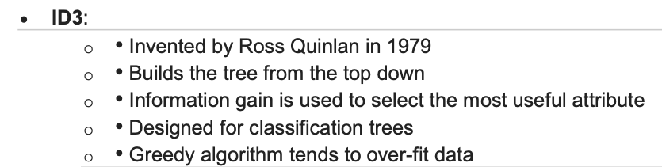
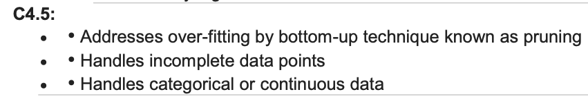
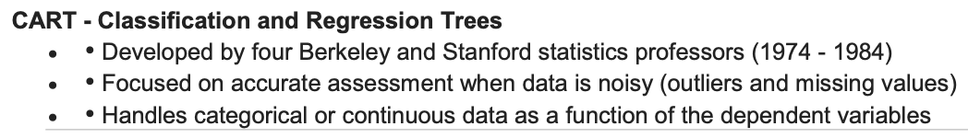

Slide 15
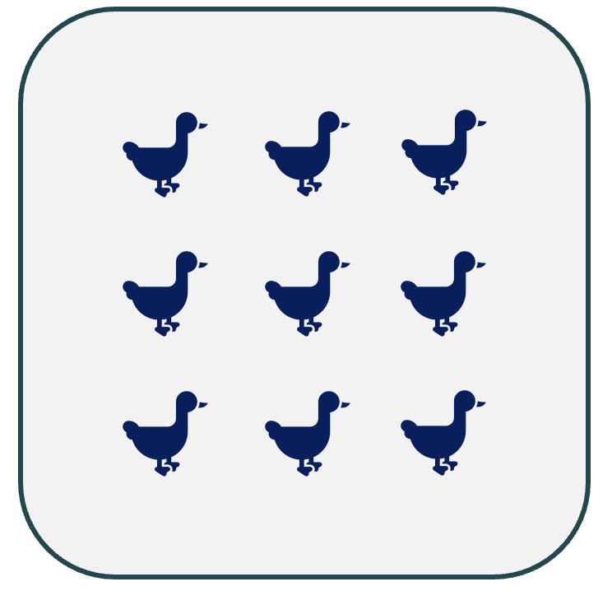

Dataset Purity
Dataset purity is an indicator of how diverse (Different) the dataset’s elements are.
When all elements inside the dataset are identical, the dataset is said to be Pure.
When every element inside the dataset is different from the other elements, the dataset is said to be Impure.

Slide 16
Partially Pure Datasets
Dataset Purity can also be measured by determining how certain we are about the type of element that is drawn (Chosen) randomly from a dataset.
More certainty means more purity (And less impurity)
Less certainty means less purity (And more impurity)
If a dataset contains 9 elements of type X and 1 element of type Y, and we draw a random element from the dataset, we will be certain 90% of the drawn element will be of type X.
This high certainty means high purity.
If one element dominates a dataset, the dataset is purer.
If a dataset contains 5 elements of type X and 5 elements of type Y, and we draw a random element from the dataset, we will be certain that 50% of the drawn element will be of type X.
This low certainty means low purity.
If no element dominates a dataset, the dataset is more impure.

Slide 17
Dataset Splitting. 1
# | Gender | Age | Major | Laptop
1 | M | 22 | IT | HP
2 | F | 21 | IT | HP
3 | M | 35 | ENG | HP
4 | F | 31 | IT | HP
5 | M | 29 | IT | HP
6 | F | 24 | ENG | DELL
7 | M | 34 | ENG | DELL
8 | F | 39 | ENG | DELL
9 | M | 25 | IT | DELL
10 | F | 30 | ENG | DELL
Splitting based on Gender (Gender = F)
Splitting based on Gender (Gender = M)
# | Gender | Age | Major | Laptop
1 | M | 22 | IT | HP
3 | M | 35 | ENG | HP
5 | M | 29 | IT | HP
7 | M | 34 | ENG | DELL
9 | M | 25 | IT | DELL
# | Gender | Age | Major | Laptop
2 | F | 21 | IT | HP
4 | F | 31 | IT | HP
6 | F | 24 | ENG | DELL
8 | F | 39 | ENG | DELL
10 | F | 30 | ENG | DELL

Slide 18
Dataset Splitting. 2
# | Gender | Age | Major | Laptop
1 | M | 22 | IT | HP
2 | F | 21 | IT | HP
3 | M | 35 | ENG | HP
4 | F | 31 | IT | HP
5 | M | 29 | IT | HP
6 | F | 24 | ENG | DELL
7 | M | 34 | ENG | DELL
8 | F | 39 | ENG | DELL
9 | M | 25 | IT | DELL
10 | F | 30 | ENG | DELL
Splitting based on Age (Age <= 30)
Splitting based on Age (Age > 30)
# | Gender | Age | Major | Laptop
1 | M | 22 | IT | HP
2 | F | 21 | IT | HP
5 | M | 29 | IT | HP
6 | F | 24 | ENG | DELL
9 | M | 25 | IT | DELL
10 | F | 30 | ENG | DELL
# | Gender | Age | Major | Laptop
3 | M | 35 | ENG | HP
4 | F | 31 | IT | HP
7 | M | 34 | ENG | DELL
8 | F | 39 | ENG | DELL
The threshold 30 was chosen randomly to split the dataset. You can choose a different threshold to split the dataset.

Slide 19
Dataset Splitting. 3
# | Gender | Age | Major | Laptop
1 | M | 22 | IT | HP
2 | F | 21 | IT | HP
3 | M | 35 | ENG | HP
4 | F | 31 | IT | HP
5 | M | 29 | IT | HP
6 | F | 24 | ENG | DELL
7 | M | 34 | ENG | DELL
8 | F | 39 | ENG | DELL
9 | M | 25 | IT | DELL
10 | F | 30 | ENG | DELL
Splitting based on Major (Major = ENG)
Splitting based on Major (Major = IT)
# | Gender | Age | Major | Laptop
1 | M | 22 | IT | HP
2 | F | 21 | IT | HP
4 | F | 31 | IT | HP
5 | M | 29 | IT | HP
9 | M | 25 | IT | DELL
# | Gender | Age | Major | Laptop
3 | M | 35 | ENG | HP
6 | F | 24 | ENG | DELL
7 | M | 34 | ENG | DELL
8 | F | 39 | ENG | DELL
10 | F | 30 | ENG | DELL

Slide 20
Dataset Splitting
Which one of the above splits did result in the purest datasets?
It is obvious that splitting based on the Major resulted in the purest datasets.
It is because every smaller dataset almost has identical elements.
That is why we had a more efficient decision tree when we initially used the Major to build the decision tree.
The key factor we use to specify the sequence of features to build the decision tree is the Dataset Purity when Splitting the Dataset.

Slide 21
Attribute Selection Measures
There are several measures that could be used to select the attributes (Features) to split the dataset.
These measures are called Attribute Selection Measures.
Such measures should assign a rank (Or score) to each feature.
This rank (Score) will determine the next splitting attribute.
Most popular Attribute Selection Measures:
Information Gain (IG)
Gini-Index
Chi-Square

Slide 22
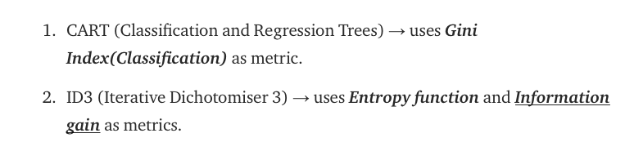
CART & ID3
Scikit-Learn uses the CART algorithm by default, which produces only binary trees: non-leaf nodes always have two children (i.e., questions only have yes/no answers).
Other algorithms, such as ID3, can produce Decision Trees with nodes that have more than two children.

Slide 23
Gini Index
The Gini Index is also known as Gini impurity. It is a measure of how mixed or impure a dataset is. The Gini impurity ranges between 0 and 1,
where 0 represents a pure dataset and 1 represents a completely impure dataset (In a pure dataset, all the samples belong to the same class or category. On the other hand, an impure dataset contains a mixture of different classes or categories).
This means an attribute with a lower Gini index should be preferred. The lower the Gini impurity, the better the feature is for splitting the dataset.
A Gini Index of 0.5 denotes equally distributed elements into some classes.
It works with the categorical target variable “Success” or “Failure”.
It performs only Binary splits (doesn’t mean binary classification).
CART (Classification and Regression Tree) uses the Gini method to create binary splits.

Slide 24
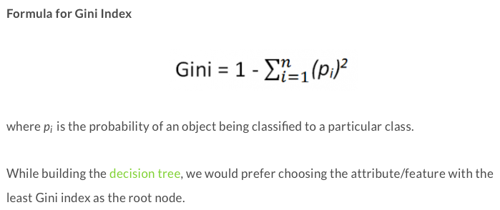
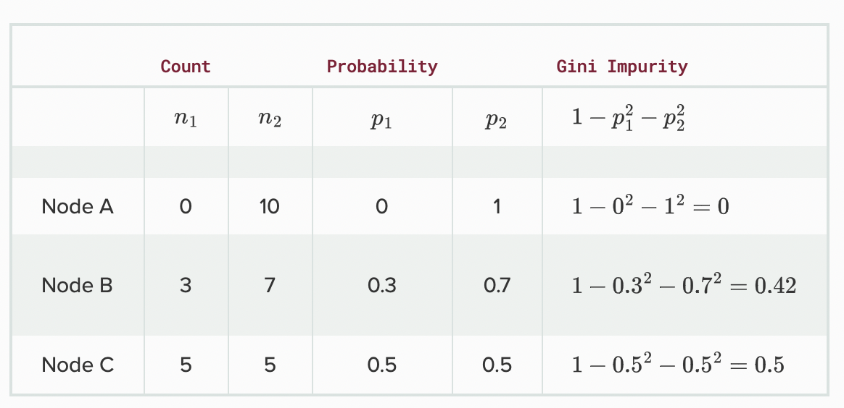
Steps to Calculate Gini for a split
Calculate Gini for split using weighted Gini score of each node of that split
example

Slide 25
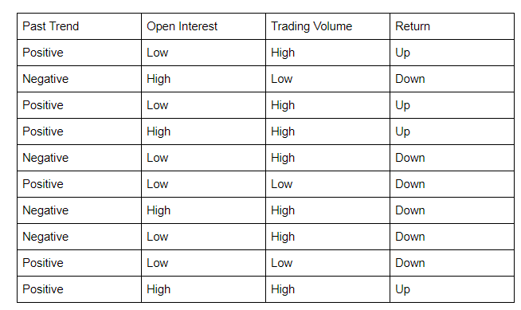
Example of Gini index Decision tree
Let’s start by calculating the Gini Index for ‘Past Trend’.
P(Past Trend=Positive): 6/10
P(Past Trend=Negative): 4/10
If (Past Trend = Positive & Return = Up), probability = 4/6
If (Past Trend = Positive & Return = Down), probability = 2/6
Gini index = 1 - ((4/6)^2 + (2/6)^2) = 0.45
If (Past Trend = Negative & Return = Up), probability = 0
If (Past Trend = Negative & Return = Down), probability = 4/4
Gini index = 1 - ((0)^2 + (4/4)^2) = 0
Weighted sum of the Gini Indices can be calculated as follows:
Gini Index for Past Trend = (6/10)0.45 + (4/10)0 = 0.27

Slide 26
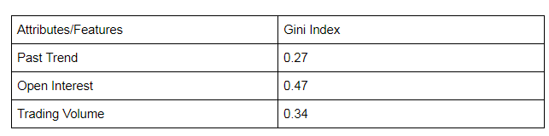
Continue of Example
Gini Index for Past Trend = (6/10)0.45 + (4/10)0 = 0.27
Gini Index for Open Interest = (4/10)0.5 + (6/10)0.45 = 0.47
Gini Index for Trading Volume = (7/10)0.49 + (3/10)0 = 0.34
We observe that ‘Past Trend’ has the lowest Gini Index and hence it will be chosen as the root node
We will repeat the same procedure to determine the sub-nodes or branches of the DT.

Slide 27
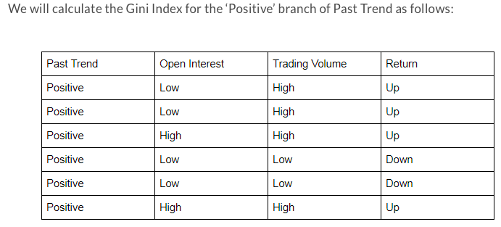
Continue of Example
If (Open Interest = High & Return = Up), probability = 2/2
If (Open Interest = High & Return = Down), probability = 0
Gini index = 1 - (sq(2/2) + sq(0)) = 0
If we do the same for the Open Interest=Low then the Gini =0.5
Continue → the weighted average of gini→
Gini Index for Open Interest = (2/6)0 + (4/6)0.50 = 0.33
Gini Index for Trading Volume = (4/6)0 + (2/6)0 = 0
We will split the node further using the ‘Trading Volume’ feature, as it has the minimum Gini index.
https://blog.quantinsti.com/gini-index/

Slide 28
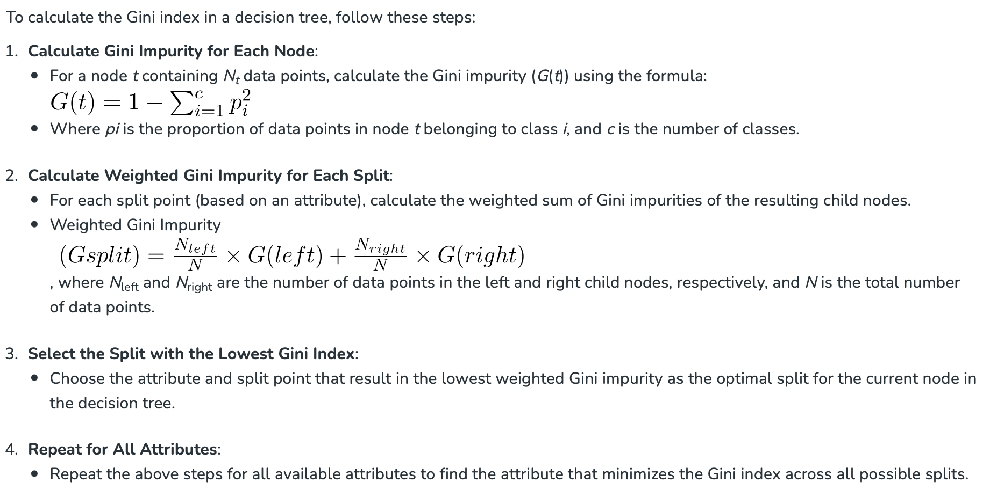
To calculate the Gini index in a decision tree, compute the sum of squared probabilities of each class subtracted from one.

Slide 29
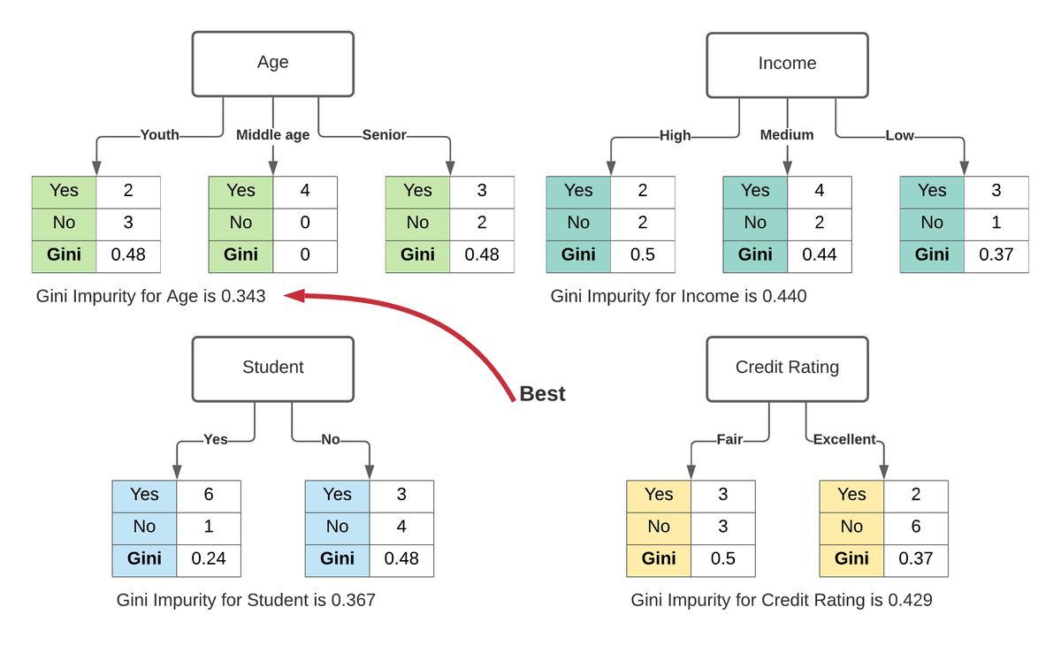
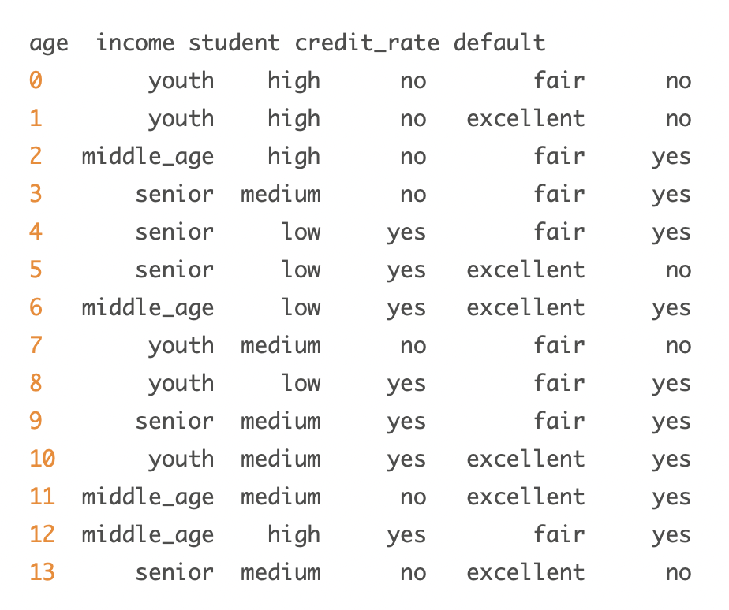
Another example ☺

Slide 30
Let’s watch the following video
https://www.youtube.com/watch?v=7VeUPuFGJHk&feature=youtu.be&t=210

Slide 31
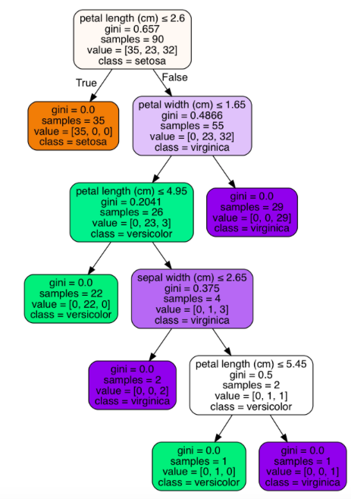
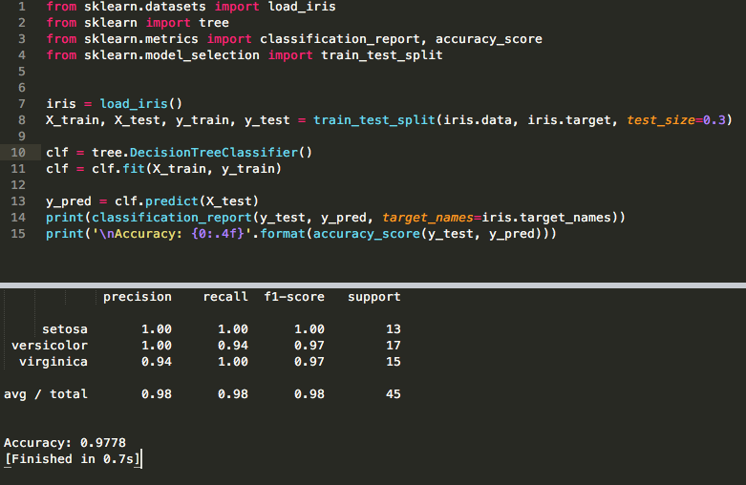
Sklearn decision tree

Slide 32
the CART (Classification and Regression Trees)
A decision tree is a binary tree, so we need to make sure that there are no more than two splits per node.
We want to make splits so that we have many examples of only one particular class and few examples of the other.
In other words, we want the split that decreases the entropy. High entropy means that we have a mix of different classes; low entropy means that we have (to a great degree) one class.
Ideally, we want our nodes to have no entropy, i.e., all examples at this node are definitely of one class.
Gini impurity and entropy mean the same thing: we want a lower Gini impurity.
Gini Impurity or Entropy? By default it is Gini (scikit learn)
The truth is, most of the time, it does not make a big difference: they lead to similar trees. Gini impurity is slightly faster to compute, so it is a good default.
Entropy tends to produce slightly more balanced trees.
clf = DecisionTreeClassifier(criterion = "gini", random_state = 100, max_depth=3, min_samples_leaf=5)

Slide 33
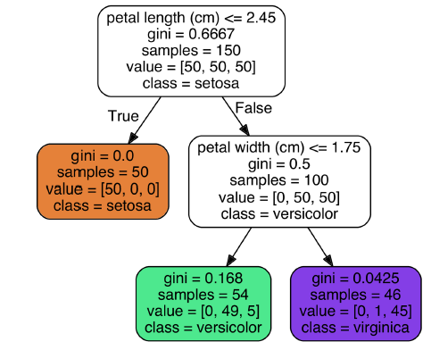



Gini and Entropy
Gini: measures the impurity of a node
(gini=0) if all training instances it applies to belong to the same class
Gini= 0.168 = 1- (49/54)^2+(5/54)^2
The Gini equation →
Entropy: it is frequently used as an impurity measure: a set’s entropy is zero when it contains instances of only one class.
Entropy equation →

Slide 34
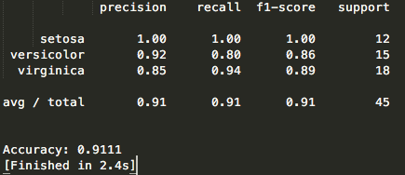
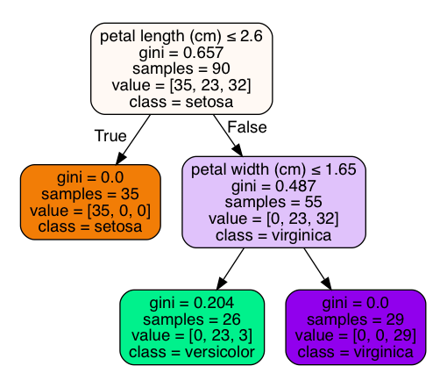
Prune
Let’s mess with the minimum entropy threshold parameter to see if we can prune this tree and how that affects the accuracy.
Let’s set it to 0.1. A node will be split if this split makes a decrease of the impurity greater than or equal to this value.
clf = tree.DecisionTreeClassifier(min_impurity_decrease=0.1)

Slide 35
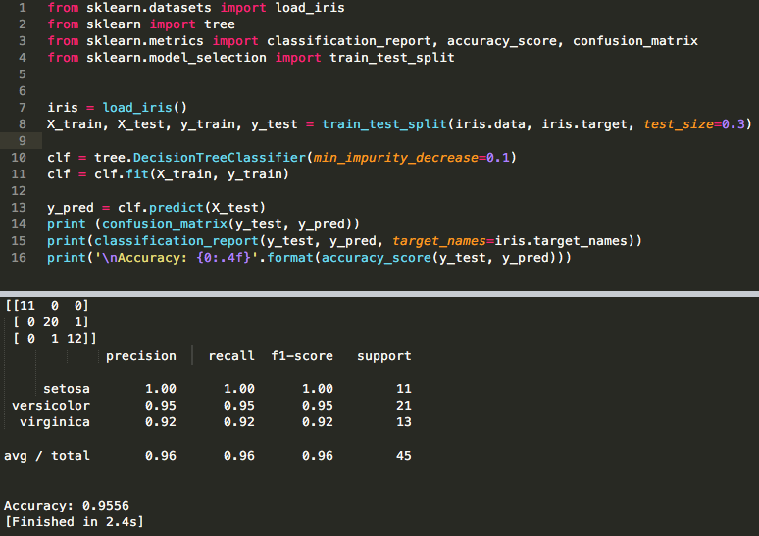
print (confusion_matrix(y_test, y_pred))

Slide 36
Tune the parameters
max_depth: int or None, optional (default=None)
The maximum depth of the tree. If None, then nodes are expanded until all leaves are pure or until all leaves contain less than min_samples_split samples.
min_samples_split: int, float, optional (default=2)
The minimum number of samples required to split an internal node
min_samples_leaf: int, float, optional (default=1)
The minimum number of samples required to be at a leaf node. A split point at any depth will only be considered if it leaves at least min_samples_leaf training samples in each of the left and right branches. This may have the effect of smoothing the model, especially in regression.
And others ☺

Slide 37
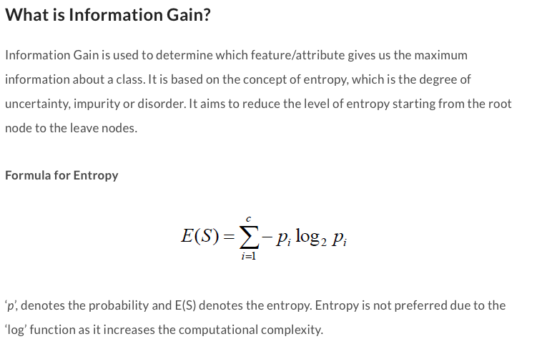
ID3
ID3 uses Entropy and Information Gain to construct a decision tree.
https://medium.com/@rishabhjain_22692/decision-trees-it-begins-here-93ff54ef134

Slide 38

Information Gain
A statistical property called information gain, measures how well a given attribute separates the training examples
Information gain uses the notion of entropy, commonly used in information theory
Information gain = expected reduction of entropy
Values(A) is the set of all possible values for attribute A, and Sv the subset of S for which attribute A has value v Sv = {s in S | A(s) = v}.
the first term in the equation for Gain is just the entropy of the original collection S
the second term is the expected value of the entropy after S is partitioned using attribute A

Slide 39
Advantages vs Disadvantages
Advantages:
Compared to other algorithms decision trees requires less effort for data preparation during pre-processing.
A decision tree does not require normalization of data.
A decision tree does not require scaling of data as well.
Missing values in the data also do NOT affect the process of building a decision tree to any considerable extent.
A Decision tree model is very intuitive and easy to explain to technical teams as well as stakeholders.
Disadvantage:
A small change in the data can cause a large change in the structure of the decision tree causing instability.
For a Decision tree sometimes calculation can go far more complex compared to other algorithms.
Decision tree often involves higher time to train the model.
Decision tree training is relatively expensive as the complexity and time have taken are more.
The Decision Tree algorithm is not very good for applying regression and predicting continuous values.

Slide 40
Scikit Learn
Scikit-learn provides two main decision tree algorithms:
CART (Classification and Regression Trees)
ID3 (Iterative Dichotomiser 3).
CART is the default algorithm used in scikit learn’s
DecisionTreeClassifier and DecisionTreeRegressor classes. It is a versatile algorithm that can handle both classification and regression tasks.
CART uses the Gini impurity as the splitting criterion for classification tasks, while it uses the mean squared error (MSE) as the criterion for regression tasks. Gini impurity measures the probability of misclassifying a randomly chosen element if it were randomly labeled according to the class distribution in the node. MSE, on the other hand, quantifies the average squared difference between the predicted and actual values in a regression problem.

Slide 41
Scikit Learn (CART , ID3)
Scikit-learn’s implementation of CART also supports various strategies for handling categorical features, including one-hot encoding and integer encoding. However, CART does not support handling missing values directly. Instead, missing values need to be preprocessed or imputed before training the model.
In addition to CART, scikit-learn provides an implementation of the ID3 algorithm through the DecisionTreeClassifier class.
ID3 is an older algorithm that uses information gain as the splitting criterion for classification tasks. It selects the feature that maximizes the information gain, which measures the reduction in entropy or impurity after the split. ID3 is primarily designed for classification tasks and does not support regression.

